Slide 1
BEEP: Balanced Efficient subgraph Enumeration in Parallel
Samiran Kawtikwar*, Mohammad Almasri*,
Rakesh Nagi*, Wen-mei Hwu*†, and Jinjun Xiong*‡
*University of Illinois Urbana-Champaign, Urbana, IL, USA
†NVIDIA Corporation, Santa Clara, CA, USA
‡University at Buffalo, NY, USA
Notes:
Hello everyone, my name is <>. I am excited to be here today to present our work "Enhanced Parallel Subgraph Enumeration in CUDA".

Slide 2
Background
Our Solutions
Evaluation
Notes:
In this presentation, I will start by providing some background on what is subgraph enumeration, why it is important, and some of the existing solutions.
Then I will go over some details of our solution and evaluate the performance of our solution to the existing state-of-the-art subgraph enumerators.
Lets get started with the background

Slide 3
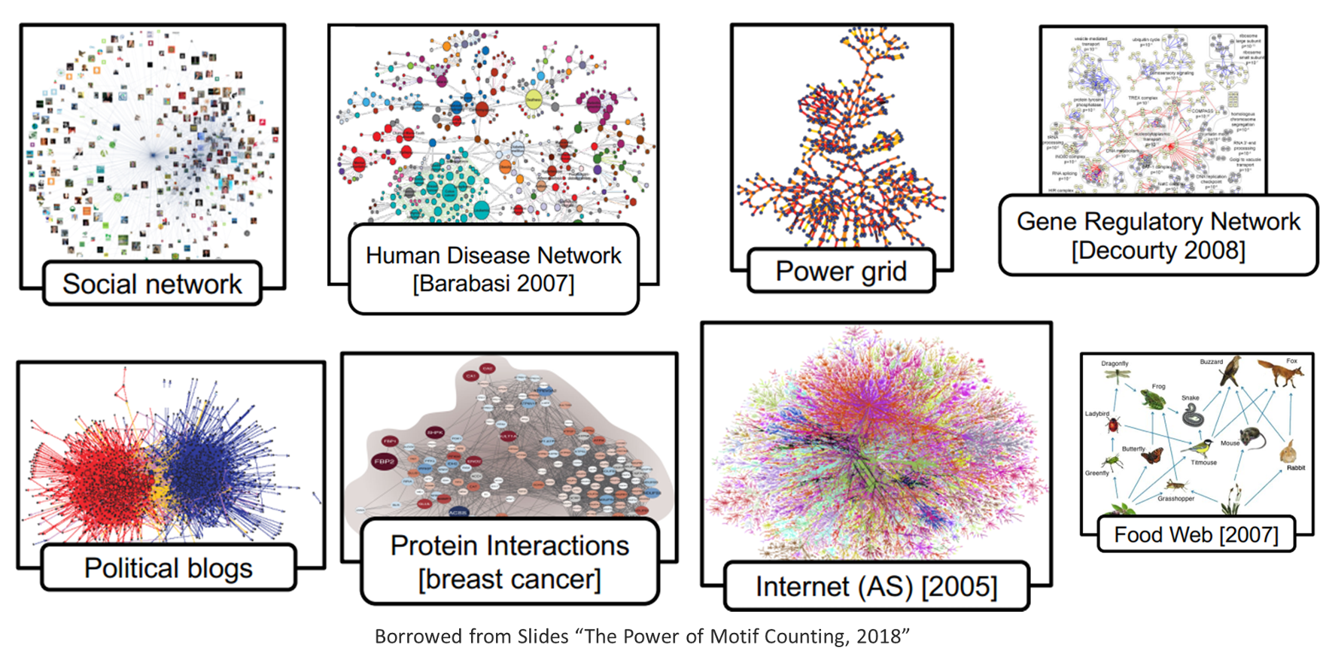
Graphs are Everywhere!
Notes:
Graphs are used in many fields.
They have high representational power and can efficiently capture complex relational information in the data.
In recent years, graph-based representations have become extremely popular for modeling real-world problems such as social networks, protein interactions, genetic networks etc.

Slide 4
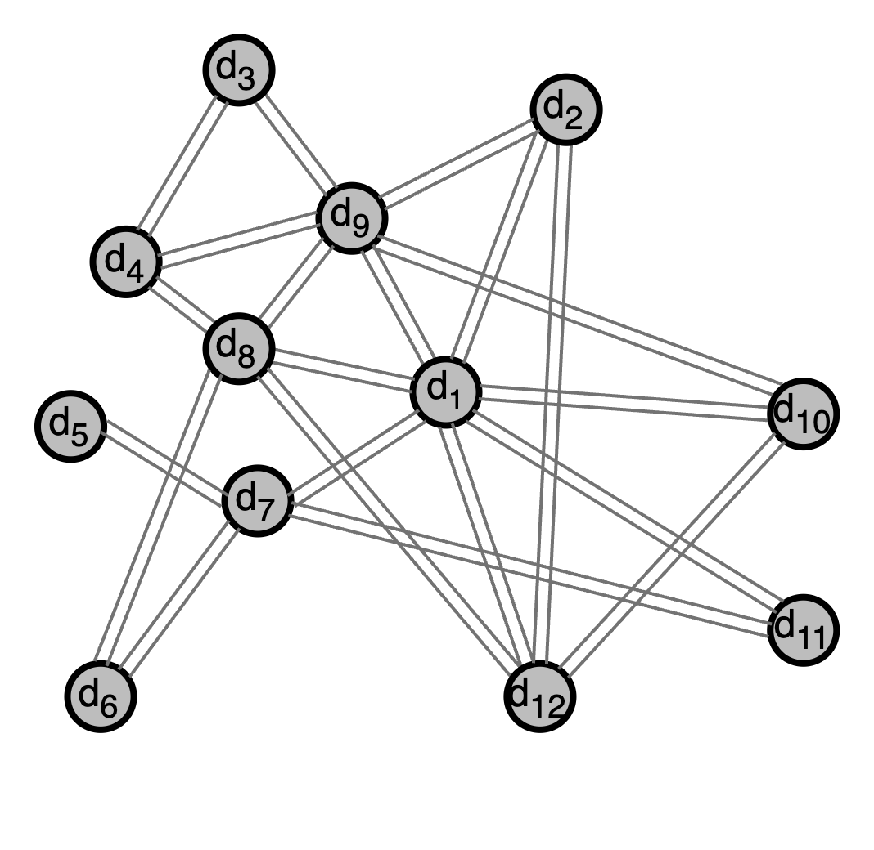
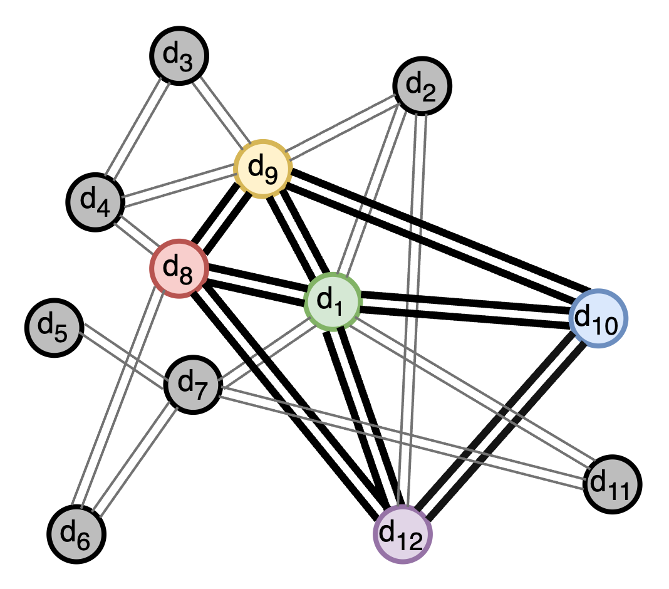
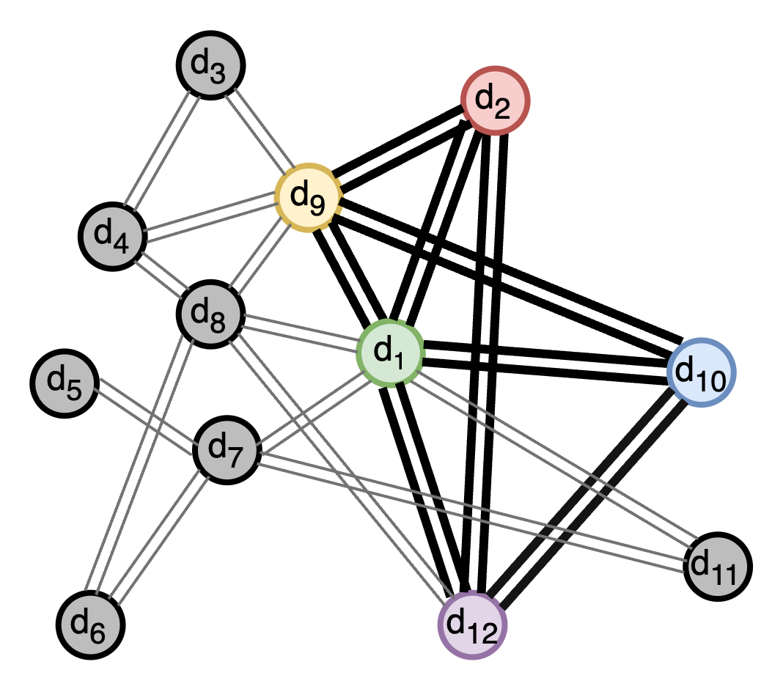
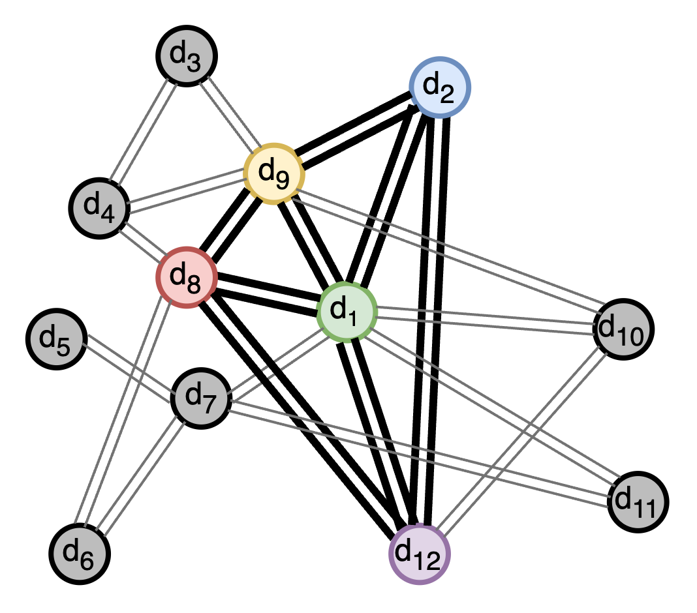
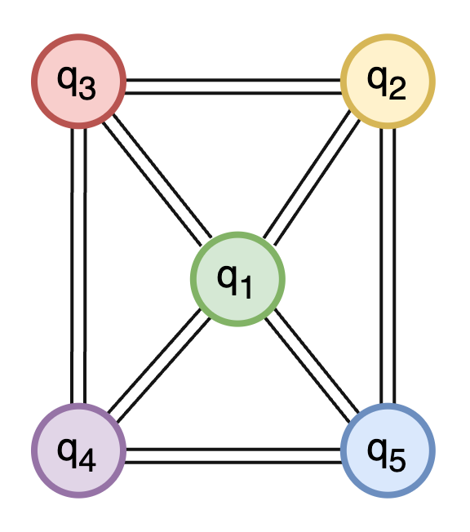
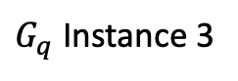
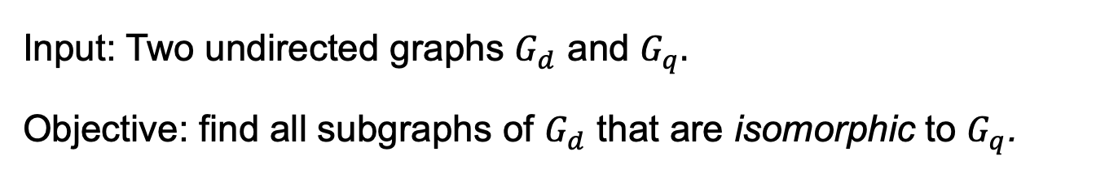
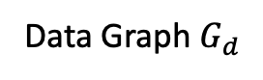
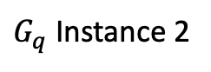
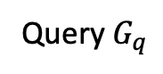
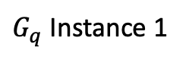
What is Subgraph Enumeration?
Input: Two undirected graphs $G_{d}$ and $G_{q}.$
Objective: find all subgraphs of $G_{d}$ that are isomorphic to $G_{q}$.
Query $G_{q}$
Data Graph $G_{d}$
$G_{q}$ Instance 1
$G_{q}$ Instance 2
$G_{q}$ Instance 3
Notes:
The objective of subgraph enumeration is to enumerate all instances of subgraphs of a data graph that are isomorphic to a given query graph.
Specifically, Given undirected data and query graph (Gd and Gq) the objective is to find all subgraphs of Gd that are isomorphic to Gq.
For example:

Slide 5
Subgraph Enumeration Applications
Wide range of applications:
Bioinformatics: Uncovering biological network function via graphlet degree signatures [1]
Social Networks: Dynamic Social Network Analysis with subgraph matching [2]
Intelligence Analysis: Fortifying Graph Intelligence with Graph Mining [3]
NLP : Plagiarism detection by Mining Contrasting Quasi-Clique Patterns [4]
Genetic Engineering: Graph mining for next generation sequencing [5]
Chemical synthesis: Walks in Molecular Graphs [6]
...

Slide 6
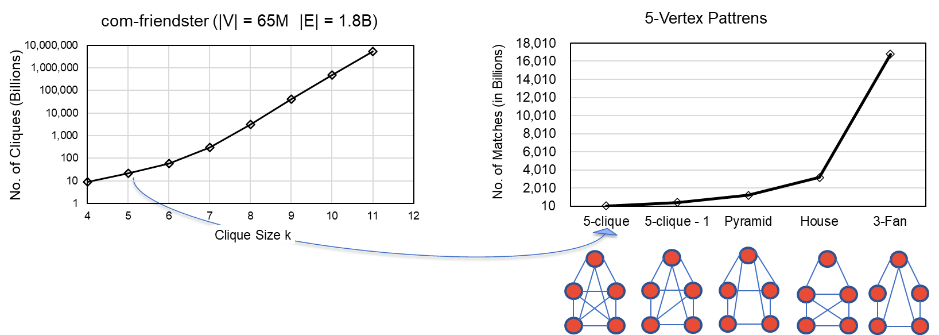
Motivation
Exponential Growth
Example from a real-world graph: # of k-cliques (fully connected subgraphs) as k increases:
High memory requirement
High computational complexity (NP-complete)
Scaling to large templates is challenging
Need scalable solutions!
Notes:
The number of enumerations of this problem grow exponentially with increasing query size
It is a challenging problem due to:
High memory requirement
High computational complexity (infact it is NP complete)
So naturally scaling the problem to large templates is challenging.
Hence, we need scalable solutions for this problem.

Slide 7
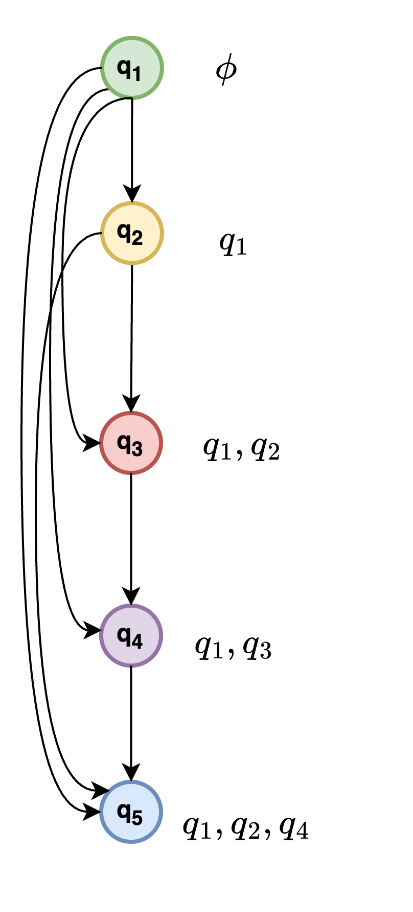
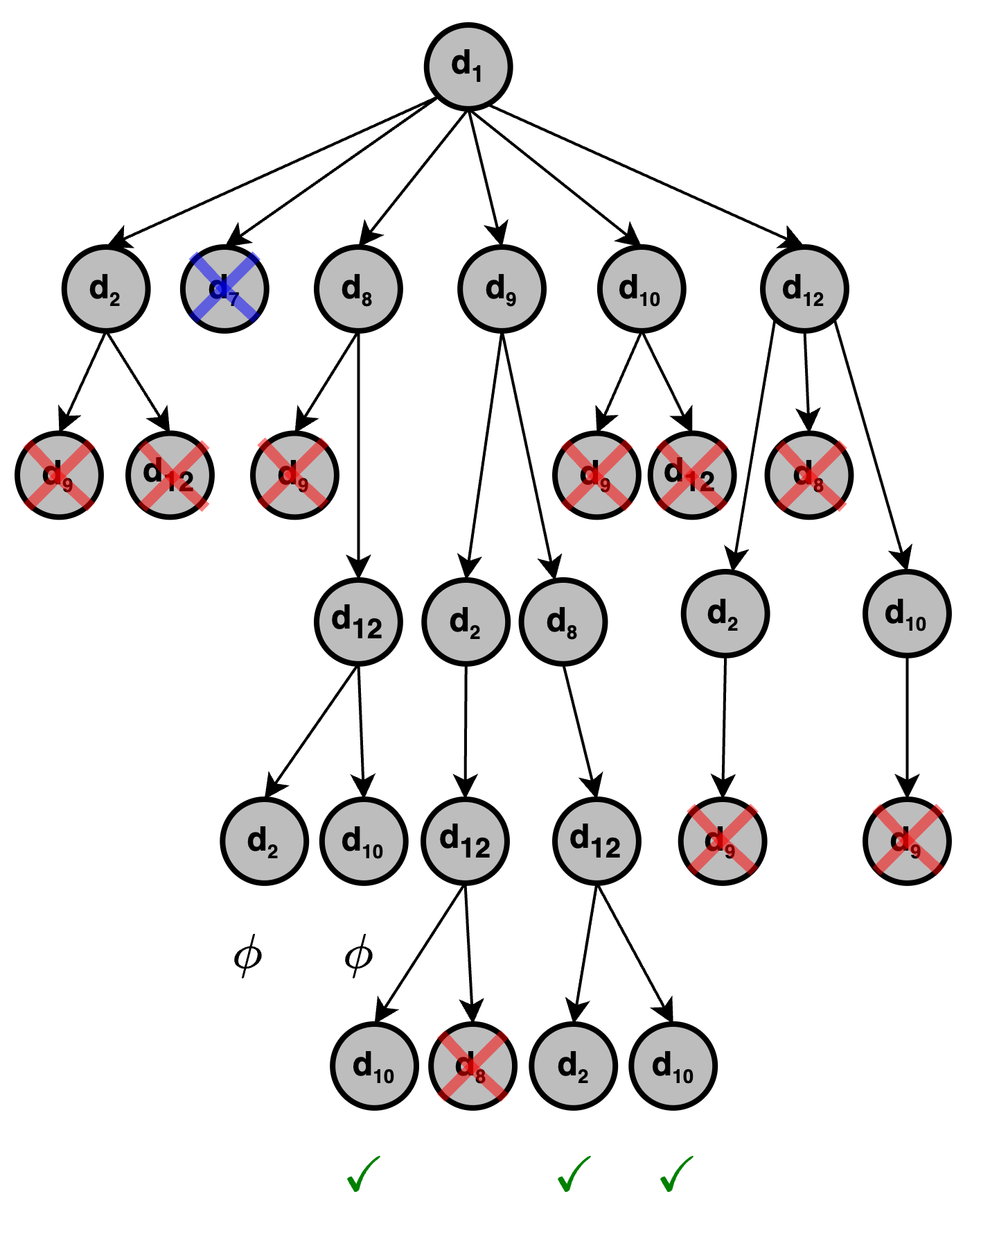
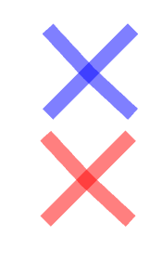
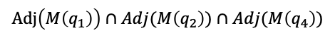


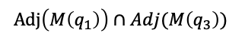
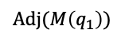
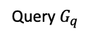
Search Tree Algorithm for Subgraph Enumeration
$$Adj(M\left(q_{1}\right))$$
$$Adj\left(M\left(q_{1}\right)\right)∩Adj(M\left(q_{2}\right))$$
Data graph
$$Adj\left(M\left(q_{1}\right)\right)∩Adj(M\left(q_{3}\right))$$
$$Adj\left(M\left(q_{1}\right)\right)∩Adj(M\left(q_{2}\right))∩Adj(M\left(q_{4}\right))$$
Query $G_{q}$
Match Order $S_{q}$
Pruned by Degree
Pruned by Symmetry
Notes:
A search tree algorithm for subgraph enumeration works this way.
So, given Gd and Gq; Gq is first converted to a math order Sq.
The candidate vertices of Gd are matched with each level in Sq.
This matching constructs a search tree.
At each level of the search tree the candidate nodes are pruned based on degree or symmetry.
The symmetry arises from the automorphism of Gq.

Slide 8
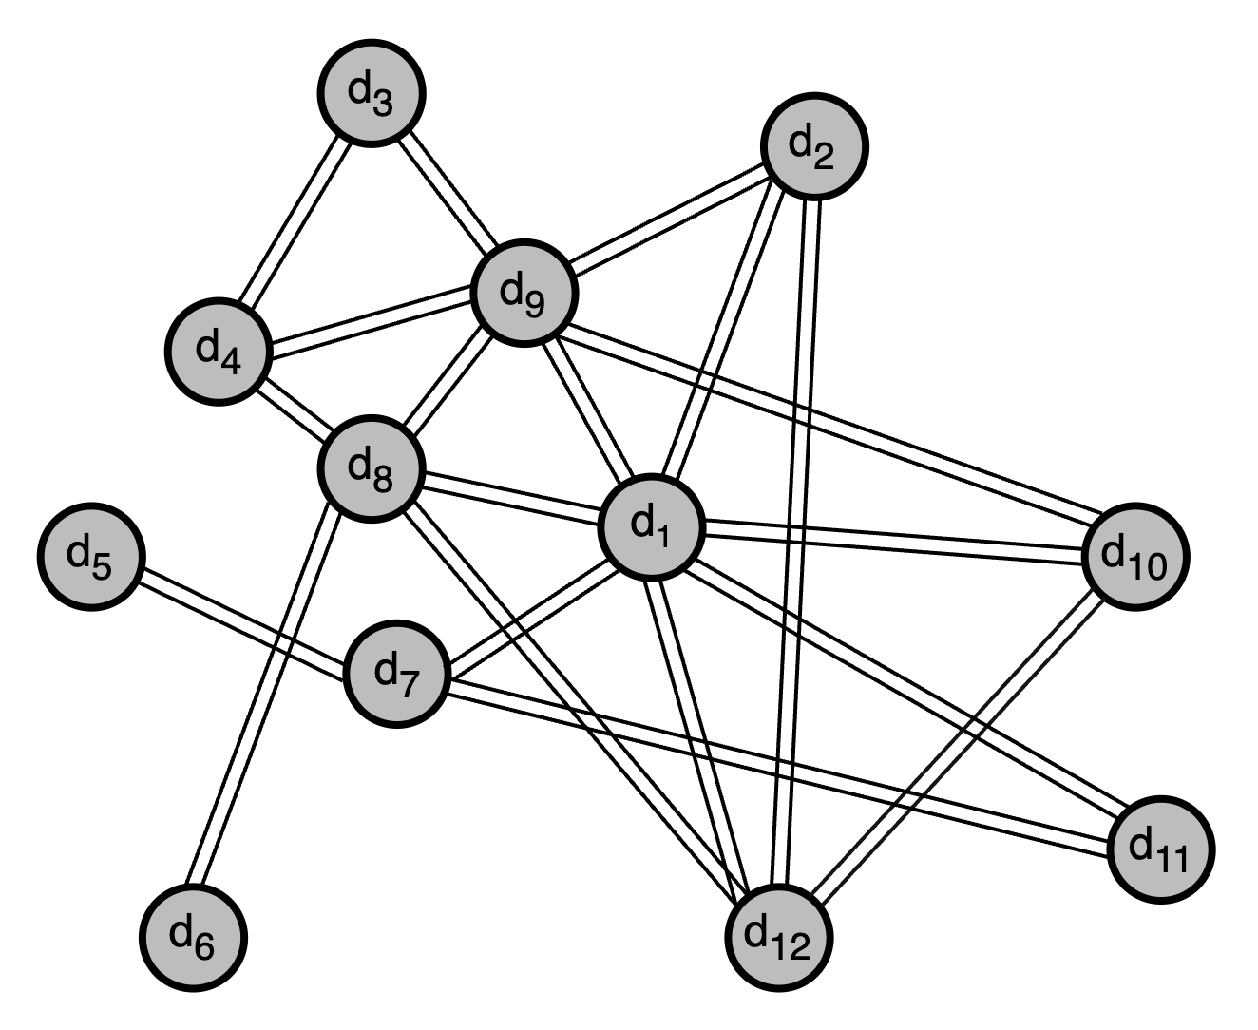
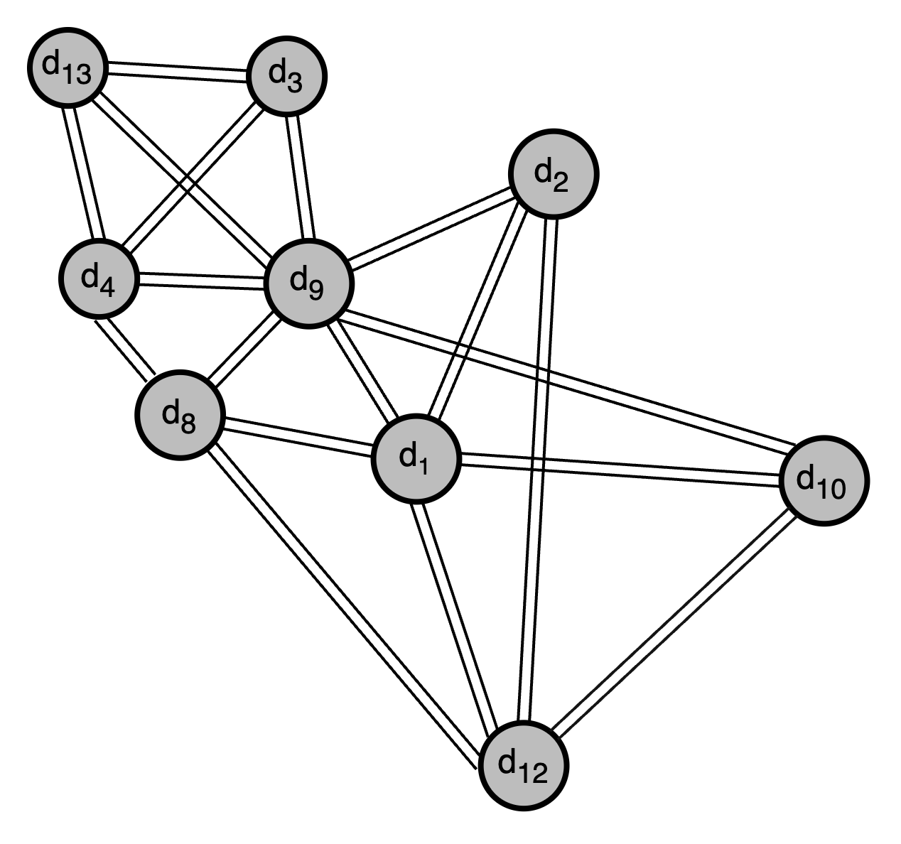
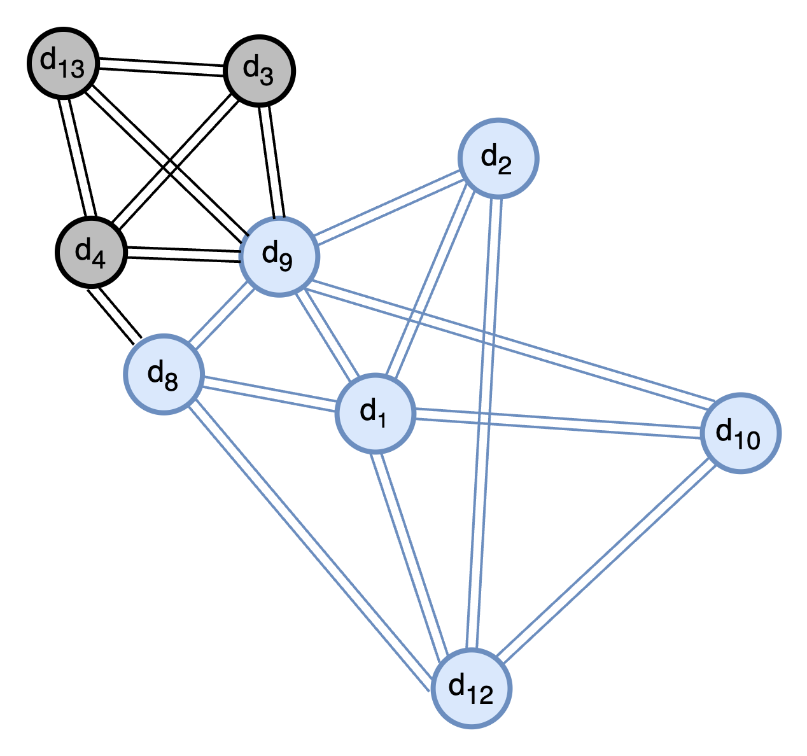
Peeling and inducing slide (min degree 3)
Data graph
Peeled Data graph
Induced graph of d1

Slide 9
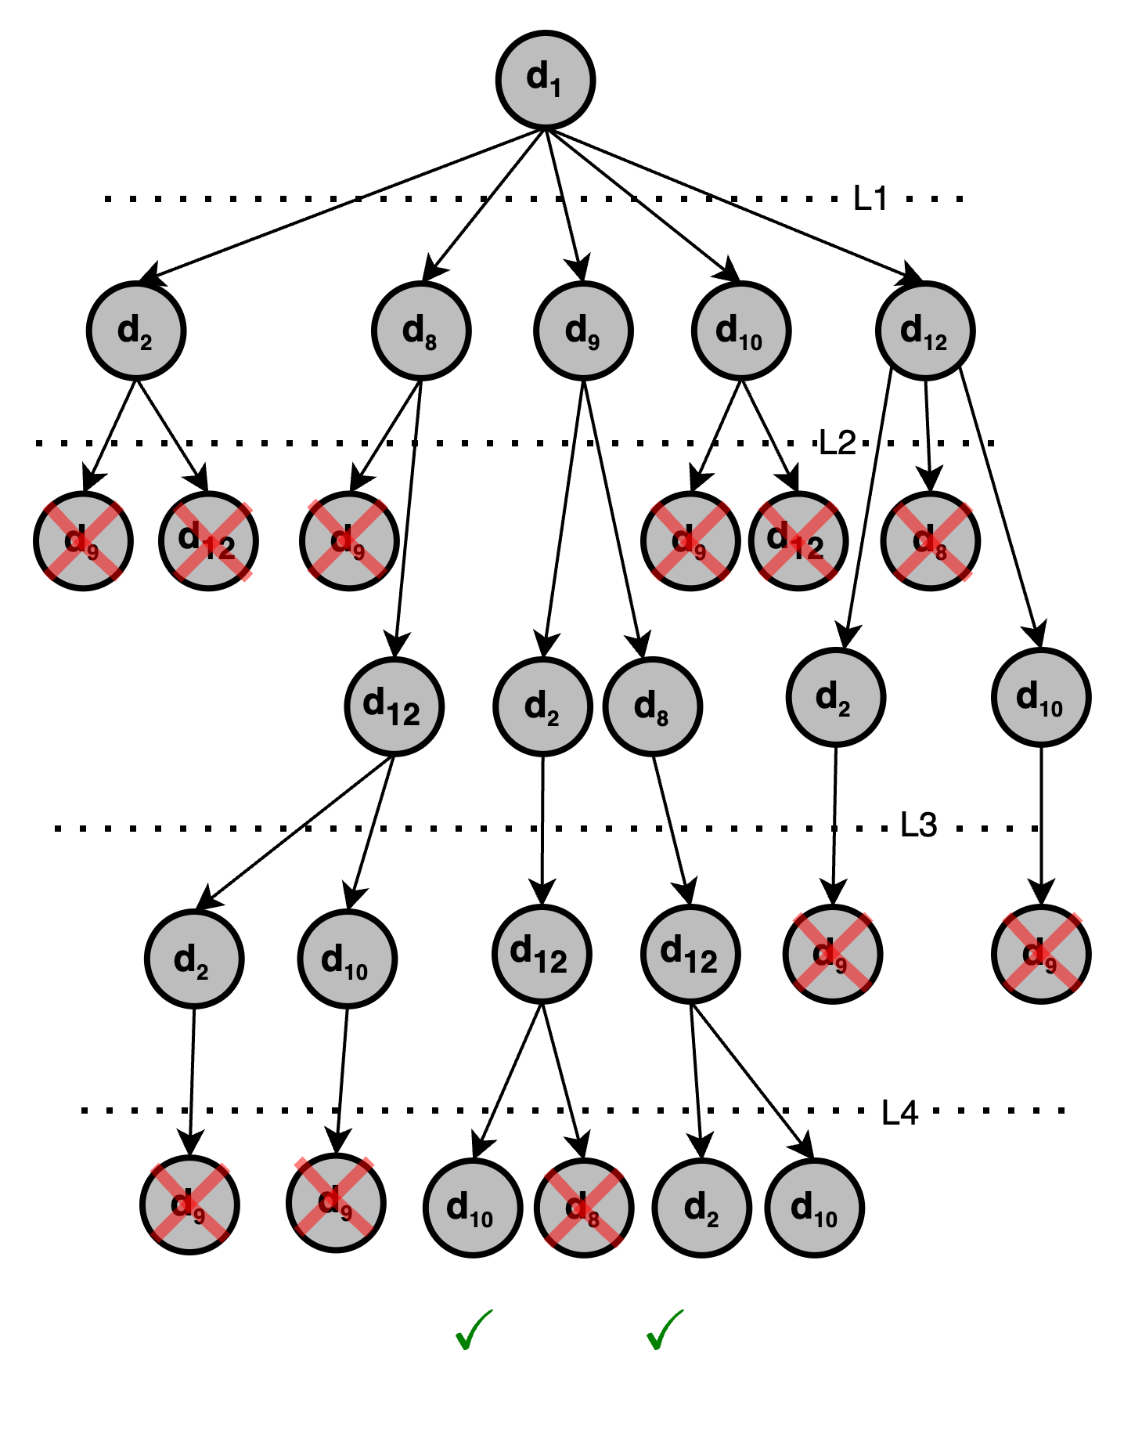
Search Tree Algorithm for Subgraph Enumeration
$$Adj(M\left(q_{1}\right))$$
$$Adj\left(M\left(q_{1}\right)\right)∩Adj(M\left(q_{2}\right))$$
Data graph
$$Adj\left(M\left(q_{1}\right)\right)∩Adj(M\left(q_{3}\right))$$
$$Adj\left(M\left(q_{1}\right)\right)∩Adj(M\left(q_{2}\right))∩Adj(M\left(q_{4}\right))$$
Query $G_{q}$
Match Order $S_{q}$
Pruned by Degree
Pruned by Symmetry
Notes:
A search tree algorithm for subgraph enumeration works this way.
So, given Gd and Gq; Gq is first converted to a math order Sq.
The candidate vertices of Gd are matched with each level in Sq.
This matching constructs a search tree.
At each level of the search tree the candidate nodes are pruned based on degree or symmetry.
The symmetry arises from the automorphism of Gq.

Slide 10
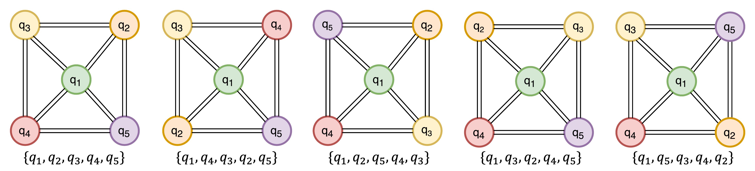
Symmetry
Following subgraphs are Automorphs
Notes:
Symmetry stands for automorphism of the underlying graph. For example, in this query all the above forms represent the same topological information. In other words, the position of nodes q2, q3, q4, q5 can be interchanged. Therefore, matching each data graph node to one q2 and q3 both would result in redundant count.
Symmetry breaking avoids this redundant count.

Slide 11
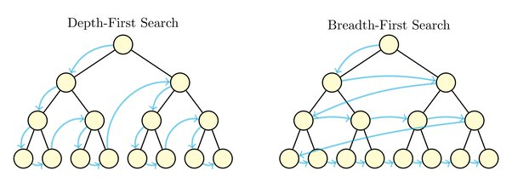
Existing Solutions
Highly parallelizable problem
CPU solutions → Depth-first search (DFS)
Good recursion support and low thread count
In memory traversal
Scalable but slow!
GPU solutions → Breadth-first search (BFS)
High thread count but poor recursion support
Huge memory requirements
Fast but not scalable!
Depth First Search
Notable Exception:
PARSEC [7] – Uses DFS on GPUs (Fast and Scalable)
Breadth First Search
Notes:
Now, lets talk about the existing solutions to this problem.
Since there are many matches available at each level, the problem is highly parallelizable.
Most CPU solutions use depth first search
CPUs have good recursion support but offer limited parallelism.
Since DFS is in memory traversal, these solutions are scalable but slow due to limited parallelism.
Most GPU solutions use breadth first search
GPUs offer massive parallelism but have poor recursion support.
BFS explode in memory requirements.
So, these solutions are fast but not scalable.
A notable exception of the GPU solutions is PARSEC which is the first DFS implementation of subgraph enumeration on GPU.
PARSEC is fast as well as scalable.
We focus on improving the performance of PARSEC.

Slide 12
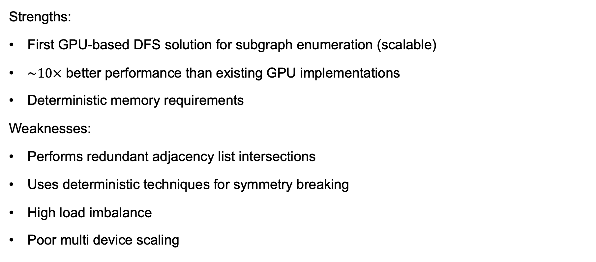
PARSEC [7]
Strengths:
First GPU-based DFS solution for subgraph enumeration (scalable)
$\sim 10×$ better performance than existing GPU implementations
Deterministic memory requirements
Weaknesses:
Performs redundant adjacency list intersections
Uses deterministic techniques for symmetry breaking
High load imbalance
Poor multi device scaling
Notes:
Now I will go over some features of PARSEC:
As we discussed, it is the first GPU-based solution that uses DFS.
It has roughly 10x better performance than existing state-of-the-art solutions
Since the DFS is in memory, it has deterministic memory requirements, contrary to BFS.
However, being the first naïve implementation of subgraph enumeration: PARSEC performs redundant adjacency list intersections
Uses deterministic symmetry-breaking techniques
Has high load imbalance across GPU cores
Does not scale well with multiple devices.

Slide 13
Background
Our Solutions
Evaluation
Notes:
I will now discuss some of our solutions and their individual impact

Slide 14
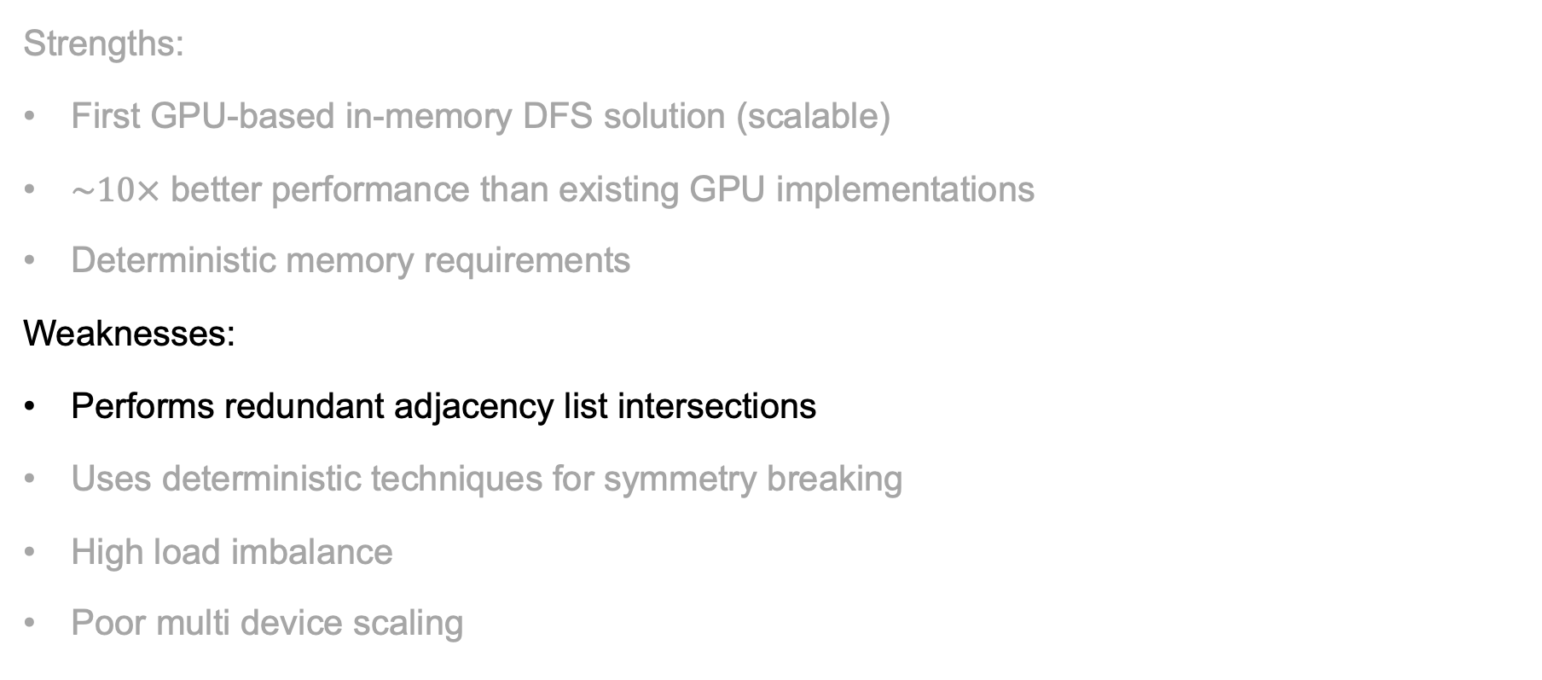
PARSEC [7]
Strengths:
First GPU-based in-memory DFS solution (scalable)
$\sim 10×$ better performance than existing GPU implementations
Deterministic memory requirements
Weaknesses:
Performs redundant adjacency list intersections
Uses deterministic techniques for symmetry breaking
High load imbalance
Poor multi device scaling
Notes:
Now I will go over some features of PARSEC:
As we discussed, it is the first GPU-based solution that uses DFS.
It has roughly 10x better performance than existing state-of-the-art solutions
Since the DFS is in memory, it has deterministic memory requirements, contrary to BFS.
However, being the first naïve implementation of subgraph enumeration: PARSEC performs redundant adjacency list intersections
Uses deterministic symmetry-breaking techniques
Has high load imbalance across GPU cores
Does not scale well with multiple devices.

Slide 15
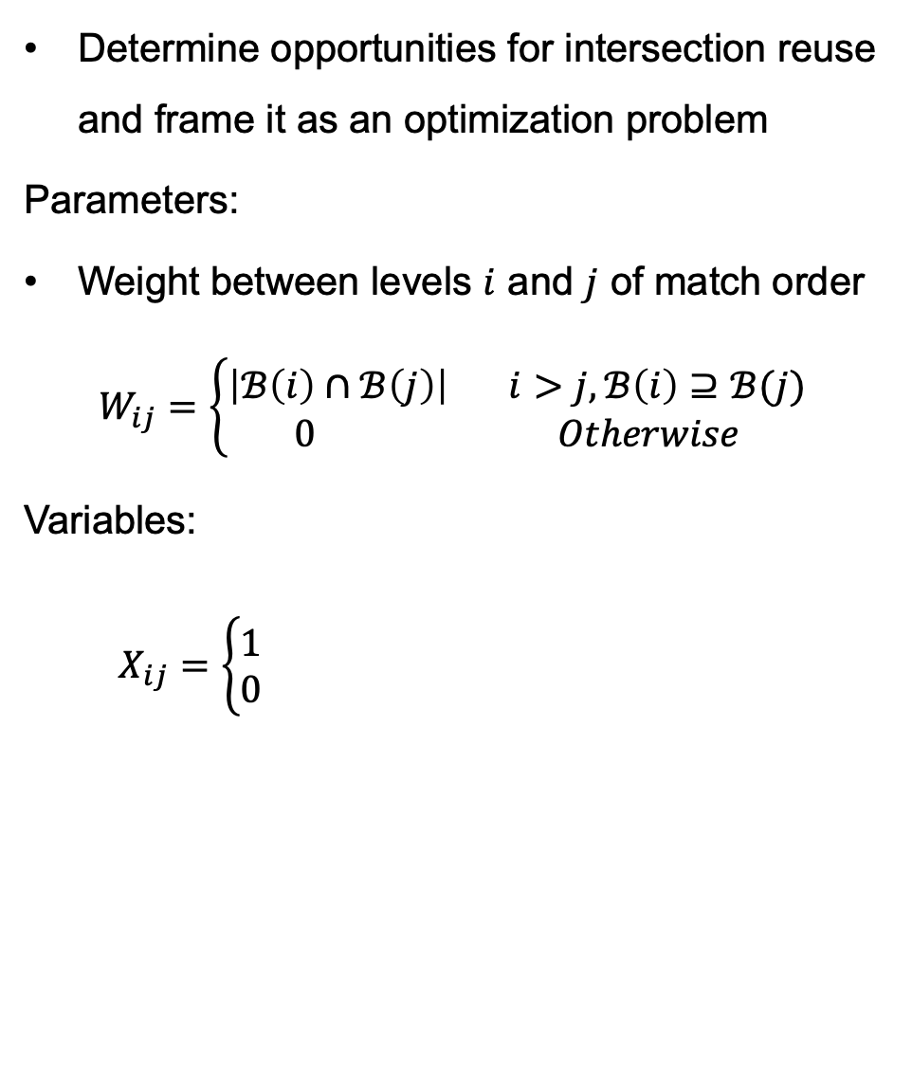
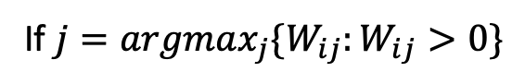
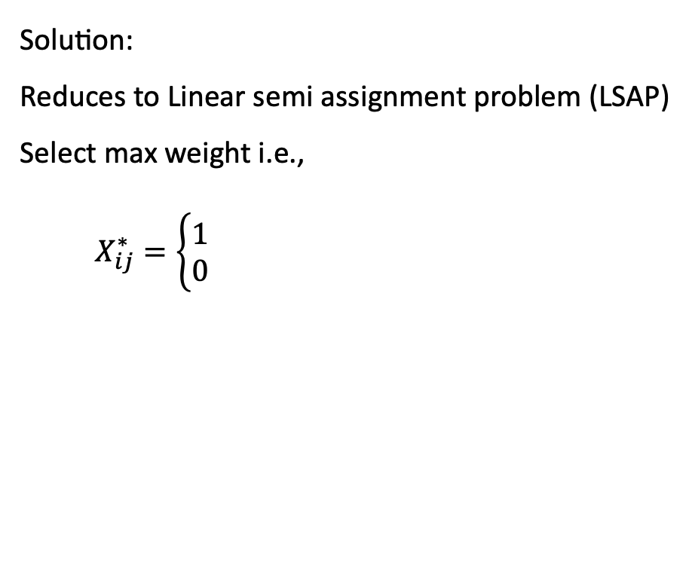
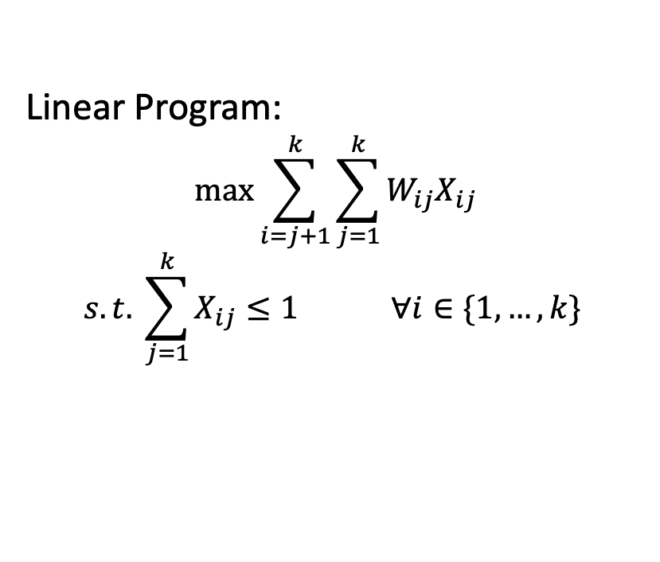
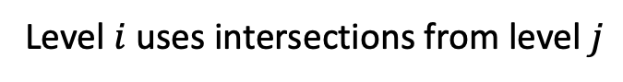
Solution 1 - Reducing list intersections
Determine opportunities for intersection reuse and frame it as an optimization problem
Parameters:
Weight between levels $i$ and $j$ of match order
$$W_{ij}=\left\{\begin{aligned}\left|ℬ\left(i\right)∩ℬ\left(j\right)\right| i>j, ℬ\left(i\right)⊇ℬ(j) \\ 0 Otherwise\end{aligned}\right.$$
Variables:
$X_{ij}=\left\{\begin{aligned}1 \\ 0\end{aligned}\right.$
Linear Program:
$$\max{\sum_{i=j+1}^{k}{\sum_{j=1}^{k}{W_{ij}X_{ij}}}}$$
$$s.t. \sum_{j=1}^{k}{X_{ij}≤1} ∀i∈\{1,…,k\}$$
Solution:
Reduces to Linear semi assignment problem (LSAP)
Select max weight i.e.,
$X_{ij}^{∗}=\left\{\begin{aligned}1 \\ 0\end{aligned}\right.$
Level $i$ uses intersections from level $j$
Otherwise
If $j=argmax_{j}\{W_{ij}:W_{ij}>0\}$
Otherwise
Notes:
Our first solution reduces the number of adjacency list intersections.
We achieve this by smartly determining the opportunities for reuse based on the query structure
To quantify the reuse we define Wij between levels I and j and decision variables X_ij.
With this the reuse problem converts to a linear program which can be easily solved with a closed form solution

Slide 16
Solution 1 - Impact
Data graph: com-youtube
Notes:
Here is a graphic that shows the improvement in number of intersections

Slide 17
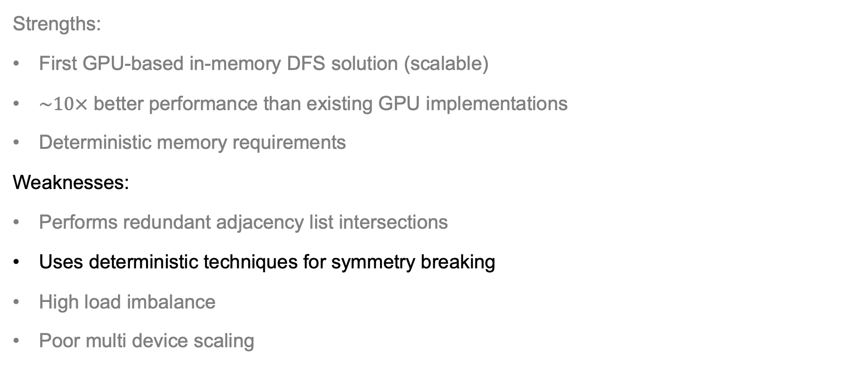
PARSEC [7]
Strengths:
First GPU-based in-memory DFS solution (scalable)
$\sim 10×$ better performance than existing GPU implementations
Deterministic memory requirements
Weaknesses:
Performs redundant adjacency list intersections
Uses deterministic techniques for symmetry breaking
High load imbalance
Poor multi device scaling
Notes:
Now I will go over some features of PARSEC:
As we discussed, it is the first GPU-based solution that uses DFS.
It has roughly 10x better performance than existing state-of-the-art solutions
Since the DFS is in memory, it has deterministic memory requirements, contrary to BFS.
However, being the first naïve implementation of subgraph enumeration: PARSEC performs redundant adjacency list intersections
Uses deterministic symmetry-breaking techniques
Has high load imbalance across GPU cores
Does not scale well with multiple devices.

Slide 18
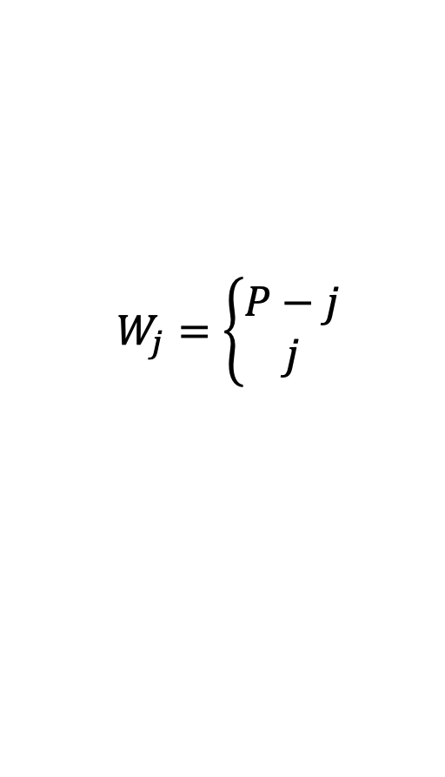

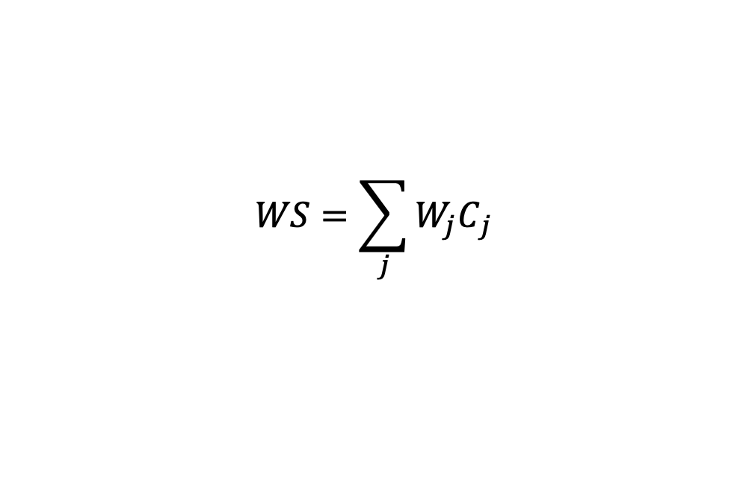
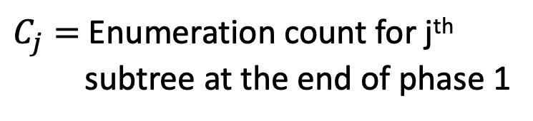
Solution 2 – Hybrid Symmetry Breaking
Observation: Symmetry Breaking direction can be independent across subtrees
2 phase approach:
Phase 1 – Partial Enumeration to decide symmetry breaking direction
Phase 2 – Performs DFS traversal for subgraph enumeration
Direction determined based on weighted sum criterion (WS):
$$W_{j}=\left\{\begin{aligned}P−j \\ j\end{aligned}\right.$$
For Increasing SB
$C_{j}=$ Enumeration count for j^{th} subtree at the end of phase 1
For Decreasing SB
$$WS=\sum_{j}{{W_{j}C}_{j}}$$
Prefer smaller $WS$
Notes:
Our second solution is to dynamically determine the symmetry breaking direction.
We show that the symmetry-breaking direction can be independent across subtrees.
To implement a hybrid strategy, we use a 2 phase approach.
Phase 1 performs a partial enumeration till first symmetric level and decides the direction
Phase 2 then performs the actual subgraph enumeration with this direction.
The direction is defined based on the weighted sum criteria, which is shown here.

Slide 19
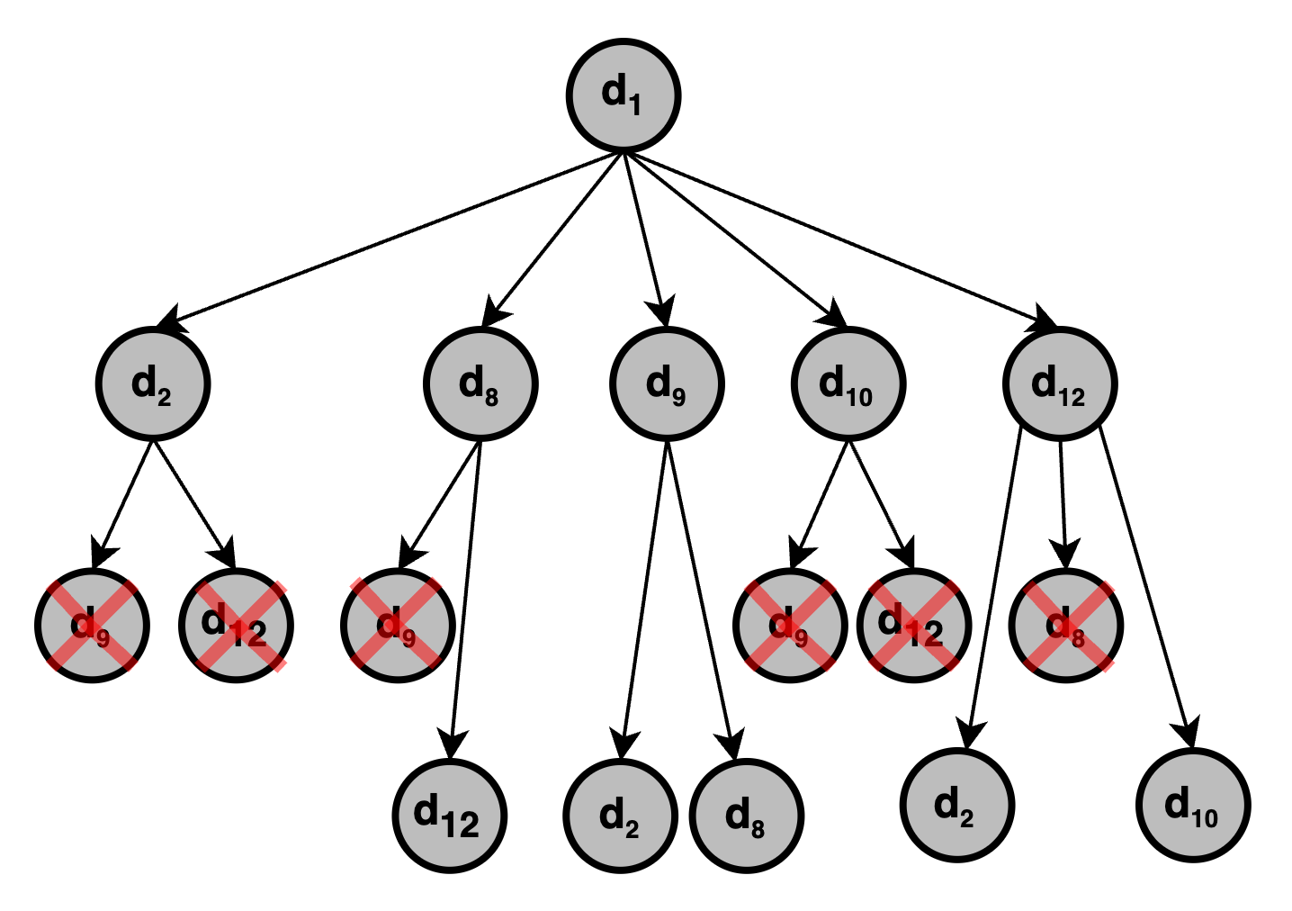
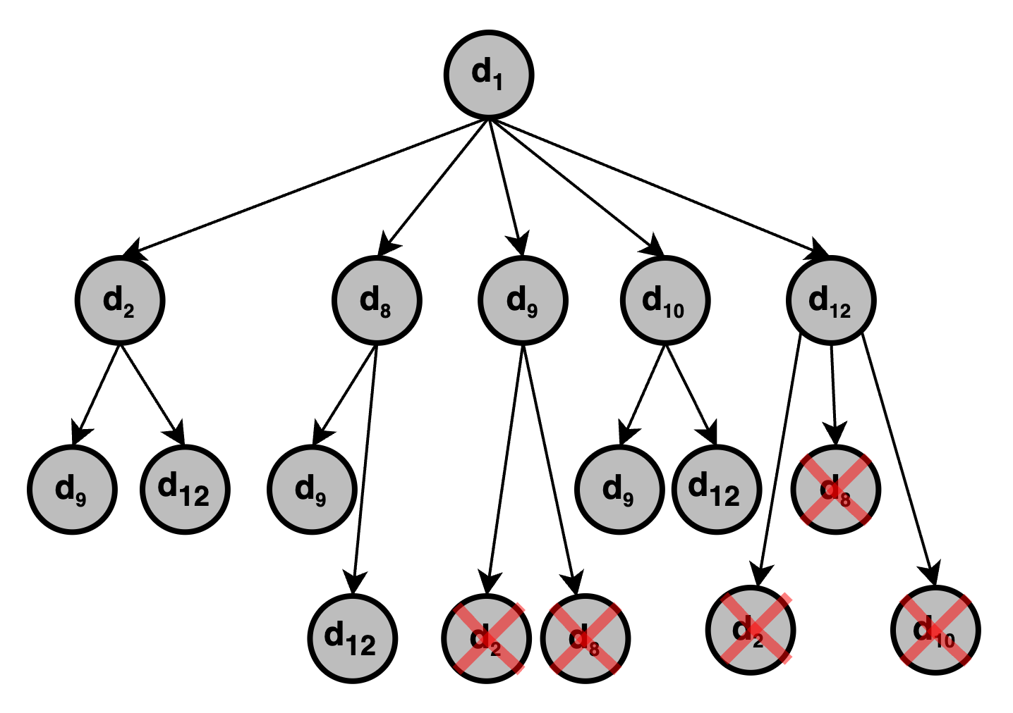
Hybrid Symmetry Breaking - Example
P=6
P=6
(6-1)*0
(6-2)*1
1*2
2*2
4*2
(6-4)*0
3*0
(6-3)*2
(6-5)*2
WS – Ascending = 12
WS – Descending = 14
Use Ascending symmetry breaking for this subtree

Slide 20
Solution 2 - Impact
Ratio
Notes:
Here we show the improvement due to solution 2 in terms of number of intersections.

Slide 21
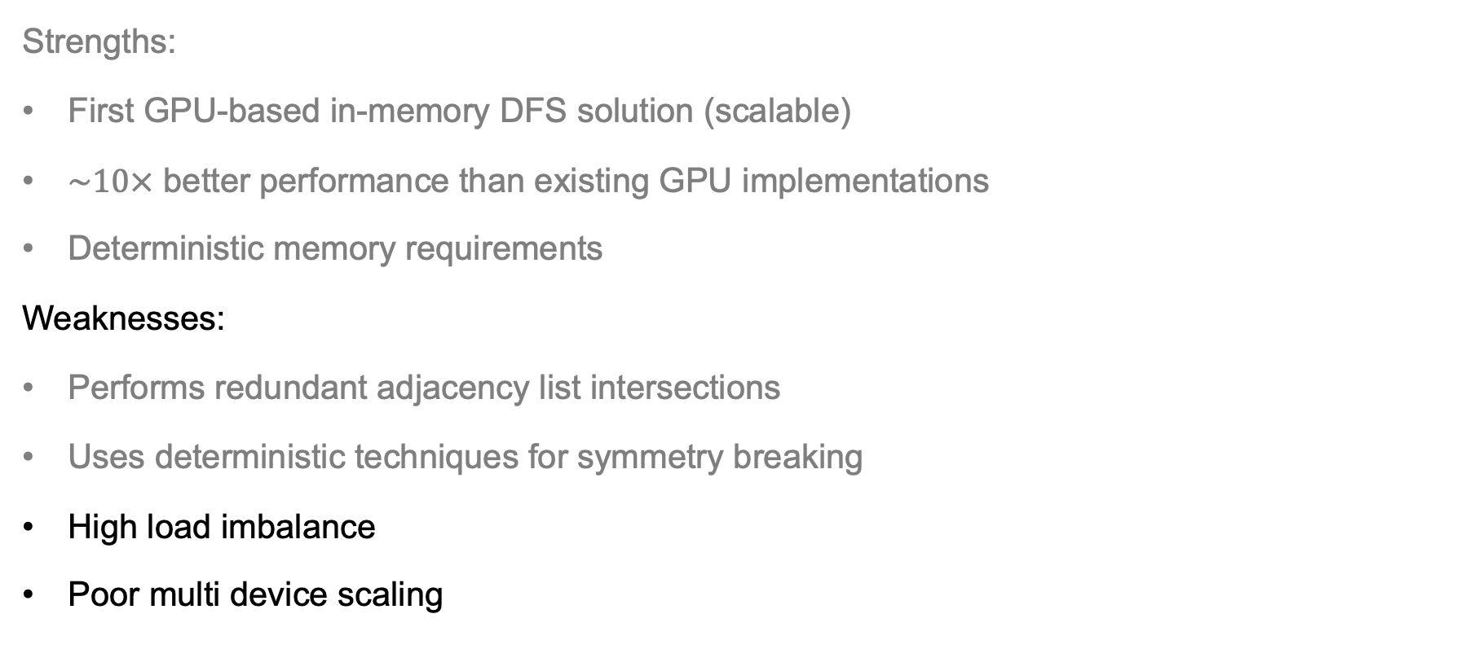
PARSEC [7]
Strengths:
First GPU-based in-memory DFS solution (scalable)
$\sim 10×$ better performance than existing GPU implementations
Deterministic memory requirements
Weaknesses:
Performs redundant adjacency list intersections
Uses deterministic techniques for symmetry breaking
High load imbalance
Poor multi device scaling
Notes:
Now I will go over some features of PARSEC:
As we discussed, it is the first GPU-based solution that uses DFS.
It has roughly 10x better performance than existing state-of-the-art solutions
Since the DFS is in memory, it has deterministic memory requirements, contrary to BFS.
However, being the first naïve implementation of subgraph enumeration: PARSEC performs redundant adjacency list intersections
Uses deterministic symmetry-breaking techniques
Has high load imbalance across GPU cores
Does not scale well with multiple devices.

Slide 22
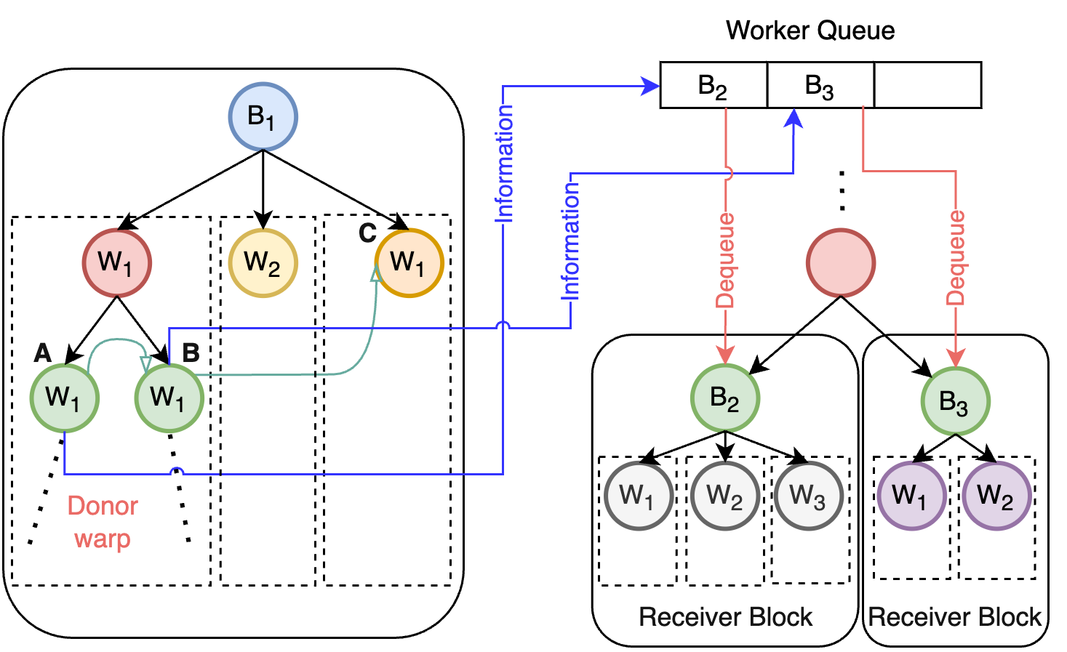
Solution 3 – Dynamic load balancing
Dynamic work sharing between GPU blocks
Tools and concepts used:
Multi-user queue
Subwarp parallelism
Contextual kernel launch
Warp = 32 threads
Block = 32 warps
Notes:
To tackle the load balancing problem, we design a dynamic work-sharing framework between GPU thread blocks.
In this framework, a busy thread block shares some of it’s work to an idle block. The idle blocks are managed using a multi-user queue which we refer to as a worker queue.
We use advanced parallel programming concepts like multi-user queue, subwarp parallelism and contextual kernel launch to achieve this

Slide 23
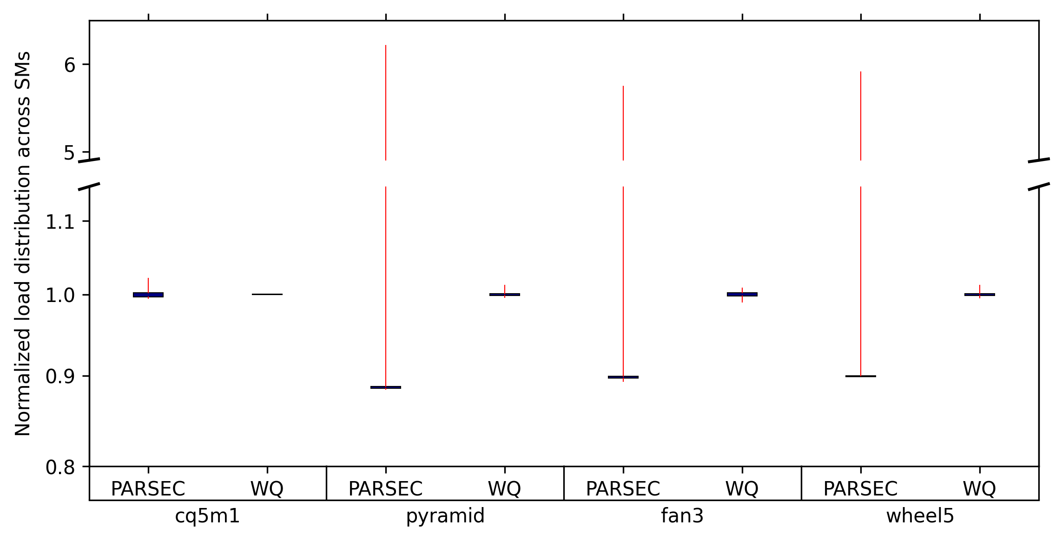
Solution 3 - Impact
Improvement in load divergence
Data graph: soc-pokec
Max divergence 1.06x
Max divergence 6.06x
Notes:
Here we show the improvement in load balance with solution 3, we can see that the new implementation has negligible load imbalance.

Slide 24
Background
Our Solutions
Evaluation
Notes:
We will now evaluate the combined performance of our improved solution

Slide 25
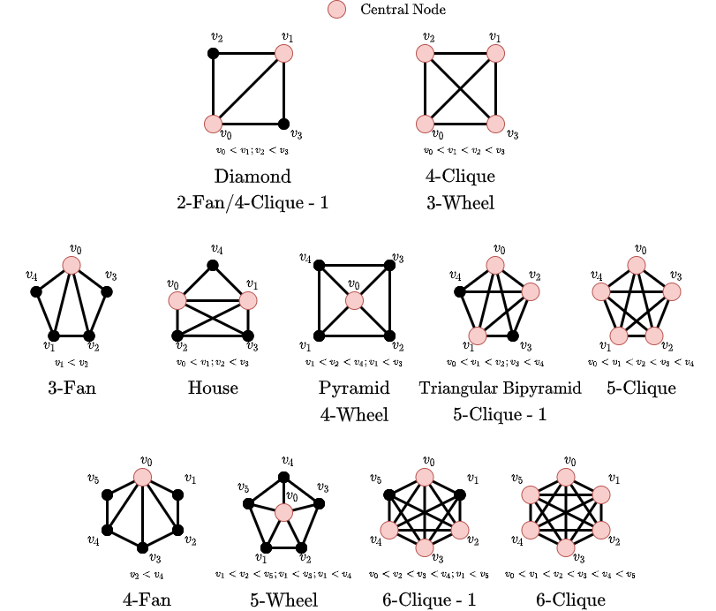
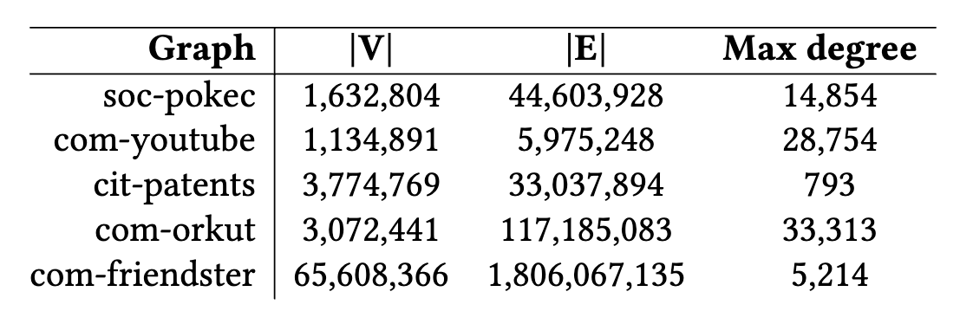
Performance Evaluation
Platform
A100 GPU with 40GB memory
AMD Milan 64 core CPU with 256 GB RAM
Data Graphs (from SNAP [8])
Baselines: PARSEC [7], cuTS
Query graphs
Notes:
We use NVIDIA A100 GPUs.
The data graphs are taken from the Stanford network analysis project (SNAP)
We test our application on these query graphs.

Slide 26
Evaluation Results - 1
geomean speedup: 7.28× (up to 21.25×)
geomean speedup: 6.96× (up to 33.46×)
Data graph: soc-pokec
Data graph: com-youtube
Notes:
As we can see, we achieve an impressive speedup of upto 21.25x and 33.46x

Slide 27

Evaluation Results - 2
geomean speedup: $6.76×$ (up to $18.21×$)
geomean speedup: $4.12×^{∗}$ (up to $11.94×$)
Data graph: cit-patents
Data graph: com-orkut
Notes:
Similar speedups follow for other graphs in the dataset

Slide 28
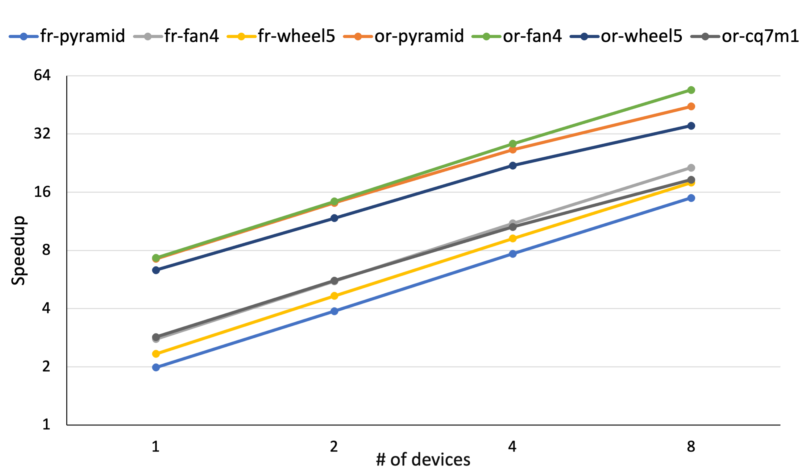
Evaluation Results - 3
Multi-device scaling
Almost linear trend on a log-log plot

Slide 29
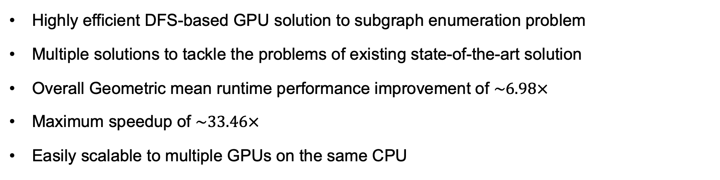
Summary
Highly efficient DFS-based GPU solution to subgraph enumeration problem
Multiple solutions to tackle the problems of existing state-of-the-art solution
Overall Geometric mean runtime performance improvement of $\sim 6.98×$
Maximum speedup of $\sim 33.46×$
Easily scalable to multiple GPUs on the same CPU
Acknowledgements
This work was partly supported by the IBM-ILLINOIS Center for Cognitive Computing Systems Research (C3SR).
This research is also a part of the Delta research computing project, which is supported by the National Science Foundation (award OCI 2005572), and the State of Illinois. Delta is a joint effort of the University of Illinois at Urbana-Champaign and its National Center for Supercomputing Applications.
We are grateful to NVIDIA's Applied Research Accelerator Program for donating two A100 GPUs, which were extremely helpful in the development stages of this work.
Notes:
To summarize,
We developed a highly efficient DFS based GPU solution to the subgraph enumeration problem
We invented multiple solutions to tackle the problems of existing solution.
Overall, we achieve a geomean runtime improvement of 6.98x with a maximum speedup of 33.46x
Our implementation is also scalable to multiple GPUs
Thank you!

Slide 30
References
[1] Milenković, Tijana, and Natasa Przulj. “Uncovering biological network function via graphlet degree signatures.” Cancer informatics vol. 6 (2008): 257-73.
[2] Christos Faloutsos. “Graph Mining and Social Networks” (link).
[3] Chris Rossbach. “Fortifying Graph Intelligence with Graph Mining” (link).
[4] Roberto Alonso and Stephan Günnemann. “Mining contrasting quasi-clique patterns” CoRR, abs/1810.01836, 2018.
[5] Warnke-Sommer, J., Ali, H. “Graph mining for next generation sequencing: leveraging the assembly graph for biological insights” BMC Genomics 17, 340 (2016).
[6] Gutman, Ivan, et al. “On Walks in Molecular Graphs.” Journal of Chemical Information and Computer Sciences, vol. 41, no. 3, May 2001, pp. 739–45,(link).
[7] Vibhor Dodeja, Mohammad Almasri, Rakesh Nagi, et al. Parsec: Parallel subgraph enumeration in cuda (IPDPS), pages 168 – 178, Lyon, France, 2022.
[8] Jure Leskovec and Andrej Krevl. 2014. SNAP Datasets: Stanford large network dataset collection.

Slide 31
Thank you!
Questions...

